Slide 1

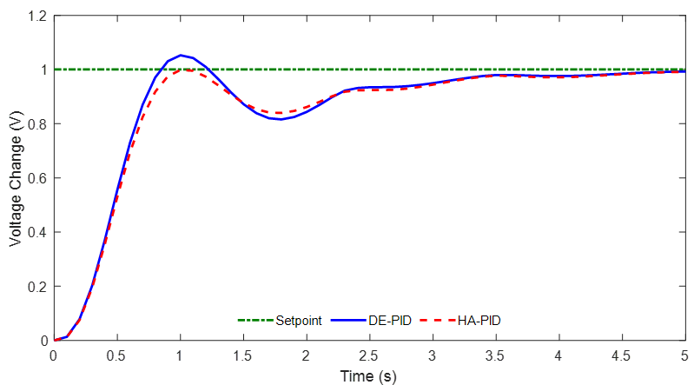
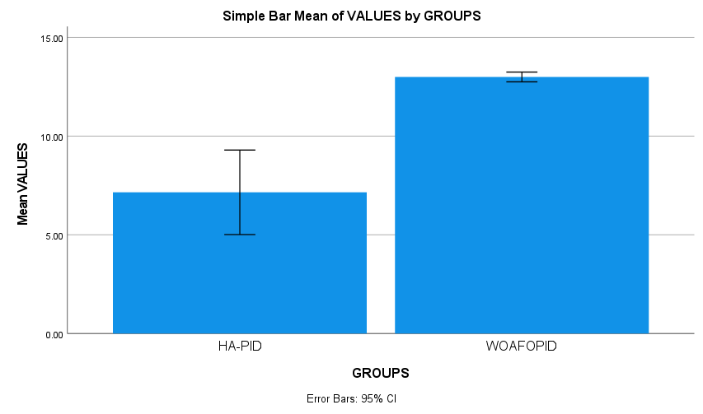



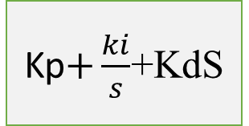

Name: Mr. S.G.M.Hussain Register Number: 192212236
Guided by Dr. V Rajinikanth
FO-PID Design with Humming Bird Algorithm for AVR system to reduce Settling time than Compared with WOA-FOPID
INTRODUCTION
AVRs play a vital role in upholding the stability and dependability of electrical power systems by maintaining a steady voltage output in spite of variations in load or input circumstances. However, the traditional method of Proportional-Integral-Derivative (PID) control remains in use.
minimizing settling time in AVRs, leading to improved stability, efficiency, and performance
The AVR rapidly reaches and sustains the desired voltage level, reducing undesired voltage fluctuations. Increased effectiveness and reducing settling periods result in more efficient functioning with the potential for decreased energy usage.
PID controllers are commonly utilized in a variety of control systems to help achieve and maintain the desired setpoint quickly after an input change, known as settling time. A prolonged settling period may result in inefficiencies and affect performance adversely.
This study focuses on methods to reduce settling time in AVR systems through the use of novel algorithms and tuning techniques to demonstrate improvements in Faster response,and improving stability and minimizing unwanted oscillations and lower Energy consumption and its lead to improve overall performance
Settling time representing with (tr) reducing settling time for AVR Systems it Achieving faster settling time may control the system components with higher bandwidth and designing Complexity and potential and instability to the system
SPSS statistical analysis confirmed the superiority of FO-PID over WOA-FOPID , with the obtained p-value confirming its statistical significance against p<0.05
MATERIALS AND METHODS
Vref(s)
Kp$+\frac{ki}{s}$+KdS
ve
$$\frac{Ka}{1+tdS}$$
Vr
$$\frac{Ke}{1+tAs}$$
vf
vt
Regulator
$$\frac{Kg}{1+tgS}$$
S
E
N
S
O
R
-
PID Controller
Exciter
Generator
Amplifier
Vs
Amplifier
Exciter
$\frac{Kr}{1+trS}$
Generator
Sensor
RESULTS
This study explores the use of the Hummingbird Algorithm (HA) for tuning a Fractional-Order Proportional Integral Derivative (FO-PID) controller in an Automatic Voltage Regulator (AVR) system.
The main goal is to lower the Settling time as compared to the standard whale optimization Algorithm PID (WOA-PID) method used in MATLAB 2022.
SPSS software will be utilized to assess the effectiveness of FO-PID compared to WOA-PID. This comparison will assess whether FO-PID brings a substantial for to reduce settling time values
The expected result is to show how the HA-FO-PID tuner outperforms WOA-PID in significantly reducing Settling time. This results in a more reliable and effective functioning of the AVR system.
The goal is to achieve a substantial decrease in Settling time when compared to the traditional WOA-PID method.
The outcome indicates that the utilization of the Hummingbird Algorithm (FO-PID) results in more effective and reduction the settling time For AVR Systems by the comparison of WOA-PID (Proportional Integral derivative )
Experimental results
This research investigates the implementation of the Hummingbird Algorithm (HA) for tuning a Fractional-Order Proportional Integral Derivative (FO-PID) controller in an Automatic Voltage Regulator (AVR) system. The primary objective is to achieve a reduction in peak voltage compared to the Whale optimization Algorithm PID (WOAPID) approach. This work considered the reduction of Rise time In AVR Systems by simulating Settling Times values by representing Graph in Mat lab Software
By adjusting the FO-PID parameters, HA aims to achieve significant reductions in peak voltage.
Traditionally, Whale optimization Algorithm PID (WOAPID) is used for AVR control.
The main goal is to demonstrate that HA-FO-PID can effectively lower peak voltage compared to WOAPID.
By adjusting the FO-PID parameters, HA aims to achieve significant reductions in peak Settling time .
Implementing HA offers a novel and potentially superior method for AVR control.
The SPSS statistical analysis confirms that the proposed study achieves a Settling time value of 15.51 and it is less than our chosen significance level (p<25.01). This authenticates that there exists a statistical significant difference between group 1 and group 2 considered in each study.
Further investigations can explore the robustness and real-world applicability of HA-FO-PID in AVR systems.
DISCUSSION AND CONCLUSION
BIBLIOGRAPHY
AFŞAR, M. A., & ARSLAN, H. (2023). Optimizing PID Gains of a Vehicle using the state-of-the-art Metaheuristic Methods. Academic Platform Journal of Engineering and Smart Systems, 11(3), 107-117. DOI:10.21541/apjess.1266949
Saha, A., Bhaskar, M. S., Almakhles, D. J., & Elmorshedy, M. F. (2024). Employment of renewable based sources in amalgamated frequency-voltage control restructured system with TSA trained IPD (1+ I) controller. Renewable Energy, 222, 119879. DOI:10.1016/j.renene.2023.119879
Altbawi, S. M. A., Khalid, S. B. A., Mokhtar, A. S. B., Shareef, H., Husain, N., Yahya, A., ... & Alsisi, R. H. (2023). An improved gradient-based optimization algorithm for solving complex optimization problems. Processes, 11(2), 498. DOI:10.3390/pr11020498
El-Dabah, M. A., Hassan, M. H., Kamel, S., & Zawbaa, H. M. (2022). Robust parameters tuning of different power system stabilizers using a quantum artificial gorilla troops optimizer. IEEE Access, 10, 82560-82579.DOI:10.1109/ACCESS.2022.3195892.
Shaheen, A. M., Elattar, E. E., Nagem, N. A., & Nasef, A. F. (2023). Allocation of PV Systems with Volt/Var Control Based on Automatic Voltage Regulators in Active Distribution Networks. Sustainability, 15(21), 15634. DOI:10.3390/su152115634

